Slide 1
Performance-Based Logistics Contracts in the Defense Logistics Agency
Initial Deliverable: Annotated Briefing
Delivered: September 30, 2014, under STP 5-03 Performance-Based Logistics Process Improvement
Notes:
Performance-Based Logistics Contracts in the Defense Logistics Agency
Principal Investigator: Andrew Hunter, Senior Fellow and Director, Defense-Industrial Initiatives Group
This annotated briefing is part of the CSIS Deliverable for Phase 2, for STP No. 5-03 Performance-Based Logistics Process Analysis, under Defense Logistics Agency Research & Development Supply Support (RDSS) Program (Prime Contract SP4701-09-D-0045).

Slide 2
Performance-Based Logistics Contracts in the Defense Logistics Agency
Overview
PBLs in Better Buying Power 2.0 & 3.0
The Overall DoD Budgetary Environment
The DLA Contract Environment
Guidance Review and Possible Measures of Success
DLA PBL Contracts and Data
Conclusions
Notes:
Contents of Phase 1 Annotated Briefing Deliverable
Background on the DoD PBL Environment
The Overall DoD Budgetary Environment
PBLs in Better Buying Power
The DLA Contract Environment
Guidance Review and Possible Measures of Success
DLA PBL Contracts and Data
Conclusions

Slide 3
Overview
DoD has successfully pursued Performance-Based Logistics contracts for nearly two decades.
The 2010 Proof Point study demonstrates the potential for benefits from increasing emphasis on PBLs.
In 2012, Better Buying Power 2.0 provided that increased emphasis.
The status of PBLs is regularly examined as part of BBP 2.0 reviews.
DLA PBLs have been largely absent from the BBP reviews.
Notes:
Background on the DoD PBL Environment
This overview briefly covers the importance of this topic. PBLs have received high level attention with analytical foundations. This is of special relevance to DLA because of the disconnect between ongoing DLA work related to PBLs and higher level visibility in the Better Buying Power reviews.
DoD has successfully pursued Performance-Based Logistics contracts for nearly two decades.
The 2010 Proof Point study demonstrates the potential for benefits from increasing emphasis on PBLs.
In 2012, Better Buying Power 2.0 provided that increased emphasis.
The status of PBLs is regularly examined as part of BBP 2.0 reviews.
DLA PBLs have been largely absent from the BBP reviews.

Slide 4
PBLs in Better Buying Power 2.0 & 3.0
Better Buying Power (BBP) initiatives, are in part a response to the overall DoD budget environment.
In 2012 BBP 2.0 called for “Increase effective use of Performance-Based Logistics.” In 2015, BBP 3.0 changed to “Enhance”
In Q&A Mr. Kendall clarified: ““counting PBLs is not the right metric, we want to make sure the ones we have are effective.” Effectiveness is to be measured by a quarterly review of benefits and savings.
Specific actions:
Guidance memo, November 2013 and April 2015.
Guidebook, May 2014 to be updated by Oct. 2015.
Incorporation into 2 classes and 10 dist. learn./online courses.
Establishment of a dedicated team of experts to assist program offices and sustainment orgs in creating and sustaining PBLs.
PBL Baseline Status Briefing (Annually in 2013) and now quarter
Notes:
PBLs in Better Buying Power
Better Buying Power (BBP) initiatives are in part a response to the overall DoD budget environment. The first Better Buying Power was issued in 2010, and version 2.0 was issued in 2012
Under BBP 2.0, the guidance was to “Increase effective use of Performance-Based Logistics”. This was undertaken by issuing the ASD(L&MR) Guidance memo of November 2013 and the release of the PBL Guidebook in May 2014.
Under BBP 2.0, the initial requirement for PBL Baseline Status Briefings was annually in 2013. That has changed to be held quarterly in 2014. However, for each of these status briefings, there were no DLA PBLs included on the charts.
On September 19, 2014, DoD issued the new BBP 3.0. It retains the focus on PBLs initiative (Quarterly Status Briefings).

Slide 5
Under Secretary Kendall on PBLs
September 19, 2014, Comments from USD(AT&L) Frank Kendall on retaining the PBL initiative in Better Buying Power 3.0:
“Increasing effective use of Performance Based Logistics” is a carry-over from [BBP] 2.0. We have made some progress in this. We have gotten out some good guidance to our workforce and we are getting some good training out; however, we are not improving our performance in this area as much as I would like to see. We are not doing more PBL type contracting. I think that that is in large part because of the difficult year we had in [Fiscal Year] ‘13. Between sequestration, furloughs, and everything else, the workload on our contracting people in particular was pretty excessive. But it is a harder way to do a contract. It takes a little bit more work than some of the other more straightforward ways, but it gets results. We need to do more of it, so we are going to continue to emphasize PBLs.”

Slide 6
The Overall DoD Budgetary Environment
Budget Planning Calendar
Budget Caps
Historical Data: Budget Outlays as % of GDP
Historical Context of the Sequester
Notes:
The Overall Department of Defense (DoD) Budgetary Environment
The Defense Logistics Agency exists inside a much larger budget ecosystem that has significant impact on the resources available and priorities to execute. In order to contextualize the push for greater use of Performance-Based Logistics, this section uses slides 5-10 to summarize the current pressures in the overall federal budget environment and on the Defense Department in particular. Collectively, the data in these slides show why proven cost-saving measures like PBLs are fundamentally important and will remain so in coming years.
The slides cover the following topics:
The Budget Caps and the 2015 Budget
Historical Data: Budget Outlays as % of GDP
Historical Context of the Sequester
Mapping the Budget Calendar

Slide 7
PB16 and the BCA Caps
FY16
OCO placeholder ($58B/year)
PB16 OCO: $58B
$159B gap between FYDP and caps
Notes:
The Budget Control Act Caps and the 2016 Budget
The primary tension in the budget today comes from the interaction between budgets requested by the President and the budget caps created by the Budget Control Act of 2011 (BCA).
In July 2011, Congress and the administration agreed on enactment of the BCA as a mechanism to reduce deficits in exchange for raising the debt limit. The Budget Control Act implemented an immediate overall spending reduction of approximately $1 trillion, which allowed the debt ceiling to be raised by $900 billion. DoD’s share was $487 billion. The second tranche of debt limit increase - $1.4 trillion - was offset by $1.2 trillion in automatic cuts over 9 years, mainly to discretionary spending. These budget cuts were enforced through the application of budget caps, split equally between defense and non-defense accounts, cutting under both tranches a total of nearly $1 trillion from the ten year defense program.
These budget caps, also known as the sequester caps, put a ceiling on defense spending that DoD, Congress, and the administration are still trying to manage. In 2013, sequester kicked in, indiscriminately cutting $31 billion out of the appropriated budget. The Bipartisan Budget Act provided a small amount of relief in 2014 and 2015, flattening the projected decline in defense funds. The red dotted line in the slide above shows the budget caps on defense mandated by the BCA (as amended) in current billions of dollars.
In the 2016 budget request and 2014 Quadrennial Defense Review, DoD declared unequivocally that the budget caps they were living under would not support the strategy needed by the nation.

Slide 8
Outlays by Military Departments as % of GDP
Actuals *
Projections *
Sources: 1962-2012 Office of Management and Budget, Historical Tables, July 2014. Available at http://www.whitehouse.gov/omb/budget/historicals; 2013-2024 Congressional Budget Office, Updated Budget Projections 2014-2024, April 2014; and incorporating updates from Congressional Budget Office, The 2014 Long-Term Budget Outlook, August 2014; Service data from DoD Greenbook FY2015
Notes:
USG Budget/Fiscal Data (current $ billions)
Historical Data: Outlays by Military Department and Defense-Wide as a % of GDP (1962-2024)
Since 1962, spending by the 3 military departments have generally tracked with one another, rising and falling together as a percent of GDP. Spending by Defense-wide accounts has been steadier, driven by periodic transfers of functions from the Military Departments to defense agencies, including DLA. Typically, these transfers produce increases in Defense-wide costs along with commensurate savings in the Military Departments. Those savings are often forgotten, even as the visibility of the increased costs remain. DLA trends are generally along the lines of the overall Defense-wide trends in this slide.
Defense-wide (including DLA) has also been hit by the draw down, but in percentage point terms the projected decline is less steep.
As a proportion of total Defense spending, Defense-wide spending is at record high levels, a trend projected to continue.

Slide 9
Mapping the FY 2015 Budget Planning Calendar
FY 2014
FY 2015
 | 2014 | 2014 | 2014 | 2014 | 2015 | 2015 | 2015 | 2015 | 2015 | 2015
 | Sept | Oct | Nov | Dec | Jan | Feb | Mar | Apr | May | June
FY2014 | Reprogramming
FY2015 |  |  | Midterm elections | FY15 NDAA | 114th Congress |  | Debt Ceiling
FY2016 | POM ‘16-’20 |  | Final budget reviews | OMB Passback |  |  | FY16 Budget Request | Budget Resolution | Start FY17 Budget Process
FY16 To Dos
FY16 NDAA
FY16 Appropriations
Debt Ceiling XO measures expire (Fall)
OCO agreement
Continuing Resolution
Omnibus Appropriations Act
Committee hearings, markup
DLA PBL Project Timeline
Phase 1 Briefing
Phase 2
Final CSIS Report: June 12, 2015
Notes:
Mapping the FY 2015 Budget Planning Calendar
At any given moment, the Department of Defense is interacting with three different budgets.
The first row shows appropriations for the current year, the funding currently being spent. September 30 is the end of FY14 budget, which is getting its final reprogramming actions and executions (and transfers involving working capital funds).
The second row is the FY15 budget budget currently under a continuing resolution but potentially fully appropriated later this year.
Finally, the third row is the budget in development, the FY16 budget and FYDP.
DoD, and by extension DLA, is in the middle of spending, appropriating, and developing three budgets, but also in the middle of executing cuts in defense spending.
With midterm elections in November 2014, FY 2015 will operate under a CR until at least December, possibly longer. A new Congress will take office in January, after an unpredictable lame duck session. The President will submit a budget in February (or more likely March) that may not be consistent with the budget caps. Then, in mid-March, the new Congress will have to address the debt ceiling even as it sets budget levels, takes testimony on, and marks up for FY 2016.
It is in the context of this budget cycle that CSIS will continue this effort on DLA PBLs. The fast-track assessment of Phase 1 is intended to provide input for inform DLA on the DoD budget review process. Phase 2 will follow the release of the president’s budget request for 2016, incorporating key information from the budget process, as well as the release of Better Buying Power 3.0 (discussed in the next 2 slides).

Slide 10
The Sequester Drawdown in Context
Post-Korea
-43%
Current
-32%
Post-Vietnam
-33%
Post-Cold War
-36%
Active Duty
Military
PB
BCA Capped Budget
1948-2014 Budget Authority
Source: Department of Defense, National Defense Budget Estimates for FY 2015 (Green Book), Office of the Under Secretary of Defense (Comptroller), March 2014; Pat Towell and Amy Belasco, Defense: FY14 Authorization and Appropriations, Congressional Research Service, January 8, 2014. Available at http://www.fas.org/sgp/crs/natsec/R43323.pdf.
Notes:
1948-2012: Budget Authority, FY 2013 Green Book
2013-2021: Sequester
Assumes sequester of DoD funds will be at current ratio of total 050 (about 96%)
Includes OCO assumptions of going down to 30k troops in Afghanistan in 2017, then remaining at that level of OCO funding in the out years.
OCO Drawdown assumption – 2013: $88.5 B, 2014: $85B, 2015: $58.6, 2016: $38B, 2017: $28B, 2018-2021: $25B/year (adjusted for inflation).
This chart shows the DoD budget from 1948 to 2019, showing all four drawdowns in defense spending in constant dollars since World War II. The drawdowns following the Korean War, Vietnam War, and Cold War are in line with the current drawdown from the wars in Iraq and Afghanistan when looking at the percent change from peak to trough. However, there are two significant differences between the current drawdown and those that came before. First, each of the previous drawdowns also had a concurrent increase in active duty troop levels (the black line), whereas the current drawdown saw nearly a 90 percent increase in spending, with almost no increase in active duty troop levels. This makes it significantly more difficult to draw down spending, as there is no increase in troops to divest. Second, the trough after previous buildups reliably returned to below $400 billion (in constant 2013 dollars). In this drawdown, the budget is expected to bottom out around $500 billion. However, internal DoD cost growth in military pay and benefits and growth in operation and maintenance spending are driving down the purchasing power of the defense dollar, meaning that while the floor of the current drawdown may be $100 billion higher than previously, DoD is not necessarily getting any more for it.

Slide 11
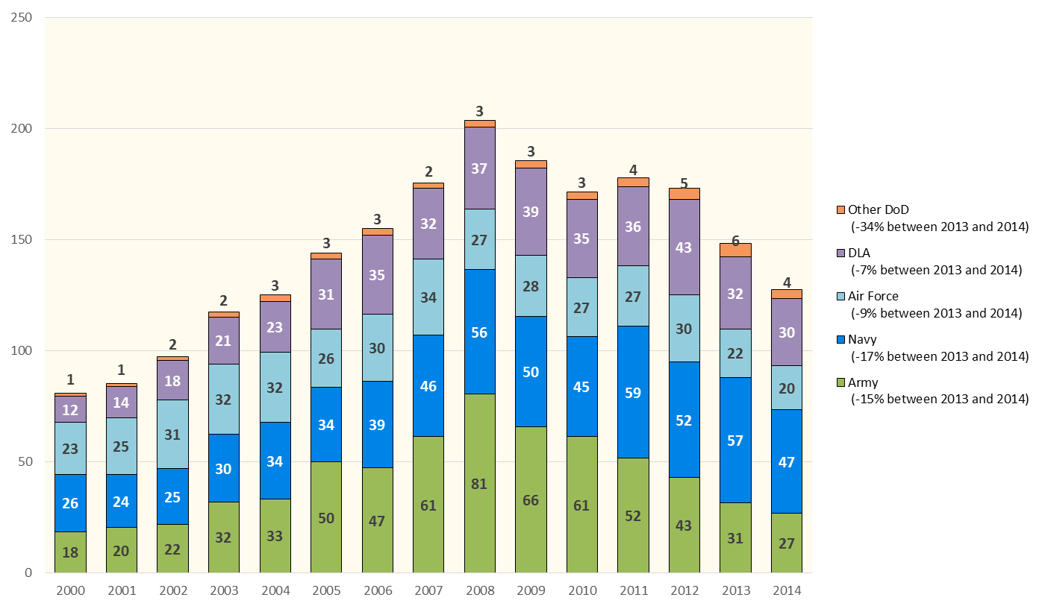
DoD Products Contract Obligations by Component, 2000-2014
Products by Component
(% Change between
2013 and 2014)
(Overall DLA: -14% between
2013 and 2014)
Notes:
Old notes:
This slide shows DoD Products Contract Obligations by Component, 2000-2013
DLA plays a significant role in DoD’s contracting for products. Excepting 2012, DLA products contract obligations have accounted for between 18 percent and 22 percent of overall DoD product contract obligations in every year since 2002.
Under sequestration, DLA products declined comparably to Army and Air Force, but this is again overstated by the FY2012 fuels anomaly (see notes on previous slide).
Assuming that the $7 billion fuels increase in 2012 is the result of the timing of purchases, smoothing that “bump” (by averaging that $7 billion across 2011-2013) would roughly halve the decline of DLA under sequestration (~11 percent decline, from $38 billion to $34 billion).

Slide 12
Overall DLA Contract Environment
Obligations by Component
Obligations by Area
Obligations by Competition
Obligations by Pricing Mechanism
Obligations by Contract Vehicle
Obligations by Vendor Size
Top DLA Vendors
Methodology
Notes:
Overall DLA Contract Environment
This section will look at how DLA contracts fit into the larger DoD budget picture and what the characteristics of the DLA contracting environment are. It will identify trends over the last 13 years, and will also note some of the impacts of sequestration in FY 2013 (the last year with complete data). At present, PBL and PBL-like contracts represent only a small proportion of DLA contract spending. Methodological notes for this section can be found below.
The data and characteristics explored this section are:
Obligations by Component
Obligations by Area
Obligations by Competition
Obligations by Pricing Mechanism
Obligations by Contract Vehicle
Obligations by Vendor Size
Top DLA Vendors
Methodology:
The Federal Procurement Data System (FPDS) was the primary source for contract data found on slides 14-22 in this annotated briefing.
Federal regulations require only that all unclassified prime contracts worth $2,500 and above be reported to FPDS.
FPDS data are constantly being updated, including those for back years. As a consequence, the dollar totals for a given year may vary between deliverables.
Contract classifications sometimes differ between FPDS and individual companies, resulting in some contracts that a company considers as services being labeled as products by FPDS and vice versa.
Overseas Contingency Operations funding and other supplemental appropriations are not separately classified in FPDS
All dollar figures are in constant 2013 dollars, and years are fiscal years.

Slide 13
DoD Contract Obligations by Component, 2000-2014
Notes:
This slide shows Department of Defense Contract Obligations by Component, 2000-2013
DLA contract obligations more than tripled between 2000 and 2009, from $13 billion to $41 billion, with proportional increases in both fuels and non-fuels products.
Since 2008, DLA has fluctuated between 9 percent and 12 percent of overall DoD contract obligations.
Under sequestration, DLA declined at a rate similar to that of Army and Air Force, but this decline is overstated due to a anomalous, one-year, ~$7 billion jump in contract obligations for fuels in FY2012. Except for that anomaly, DLA contract obligations fell significantly less under sequestration than did Army or Air Force but more than Navy (which saw increases in products contracts, primarily F-35 and ships).

Slide 14
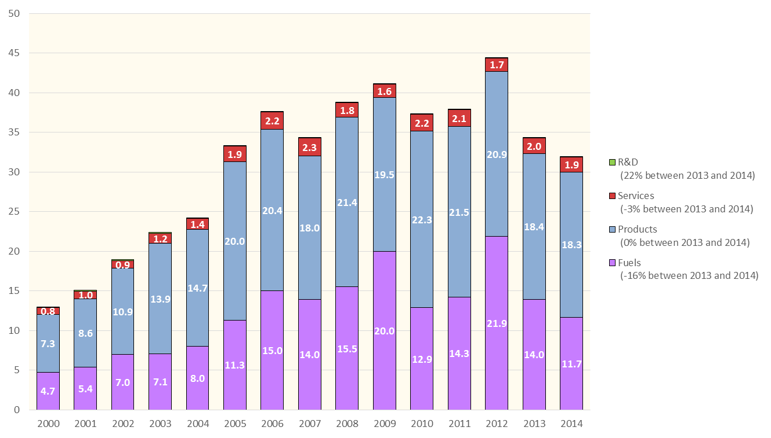
DLA Contract Obligations by Area, 2000-2014
Area
(% Change between
2013 and 2014)
(Overall DLA: -7% between
2013 and 2014)
Notes:
2013 Write-up:
This slide shows DLA Contract Obligations by Area, 2000-2013, for Products (non-fuel), Fuels, R&D, and Service Contracts
Non-fuels products accounted for nearly 60 percent of DLA contract obligations from 2000-2005, but growth in fuels (from 32 percent in 2003 to over 40 percent in all but two years from 2006-2013) reduced that share to around 55 percent in most years.
Non-fuels products, which had been increasing at a 2.4 percent CAGR, fell by 13 percent in 2013.
Fuels declined back to previous levels in 2013 after rising by nearly 50 percent in 2012.
The growth in services under sequestration was primarily in the sub-areas of Facilities-related Services & Construction (FRS&C) and Professional, Administrative, and Management Support (PAMS) services.

Slide 15
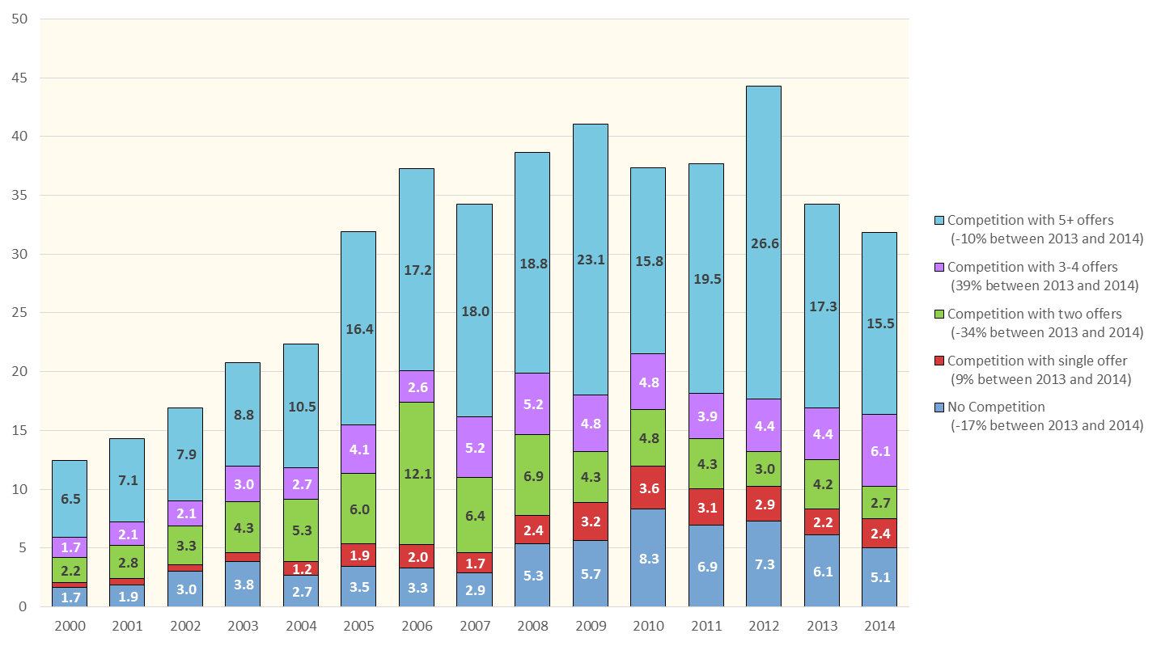
DLA Contract Obligations by Competition, 2000-2014
Level of Competition
(% Change between
2014 and 2014)
(Overall DLA: -7% between
2013 and 2014)
Notes:
2013 data:
This slide shows DLA Contract Obligations by Competition, 2000-2013
DLA has awarded at least 40 percent of contract obligations after competitions with 5 or more offers in every year during the period, by far the highest rate of any major DoD components.
Competition with 5 or more offers, which spiked between 2011 and 2012, declined by 35 percent to previous levels (50 percent share in 2013), with competition with 2 offers (7 percent in 2012, 12 percent in 2013) and competition with 3-4 offers (10 percent in 2012, 13 percent in 2013) rising as a result. These changes may be tied to the anomaly in contract obligations for fuels in 2012.

Slide 16
Contract Obligations Awarded After Effective Competition (2+ Offers), by Component, 2000-2014
Notes:
2013 data
This slide shows Contract Obligations Awarded After Effective Competition (2+ Offers), by Component, 2000-2013
“Effective Competition” is defined as competitively-solicited, awarded contracts that received at least two offers.
DLA has historically had the highest rate of effective competition among the major DoD Components, remaining at or above 75 percent in all but two years (68 percent in 2010, 73 percent in 2011) since 2004.
For the Army/Navy/Air Force, increases in the share of contract obligations going to products correlate with declines in the rate of effective competition. For DLA, this has not been true.

Slide 17
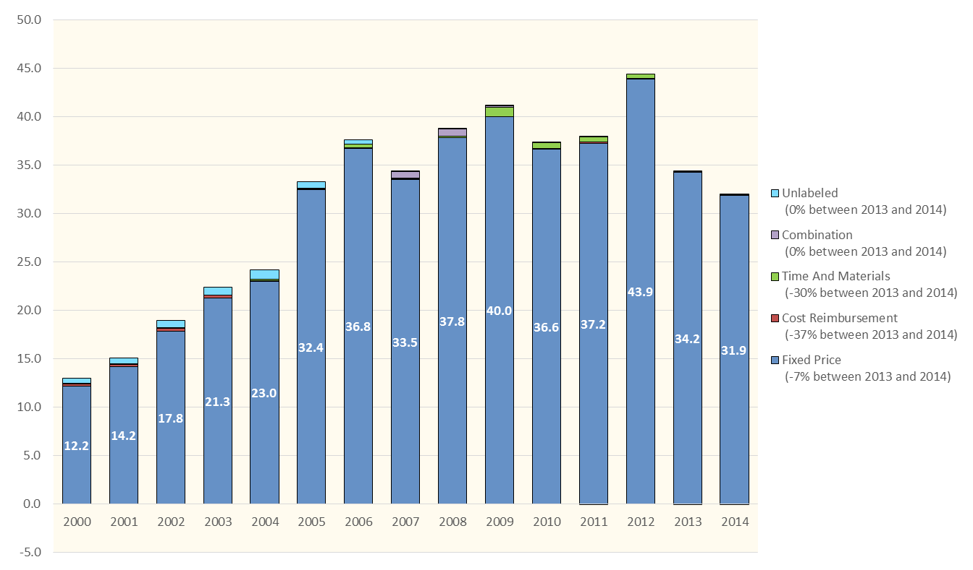
DLA Contract Obligations by Pricing Mechanism, 2000-2014
Pricing Mechanism
(% Change between
2013 and 2014)
(Overal DLA: -7% between
2013 and 2014)
Notes:
This slide shows DLA Contract Obligations by Pricing Mechanism, 2000-2013
[Note: CSIS uses the phrase “Pricing Mechanism” as a category for fixed price, cost reimbursable, and time-and-materials contract pricing mechanisms.]
99.7 percent of DLA contract obligations were awarded under fixed price contract types in 2013.
Cost reimbursement contract types accounted for 2 percent of DLA contract obligations from 2000-2002, but have not even reached 1 percent since 2003. Time and materials contract types accounted for 2 percent of DLA contract obligations in 2009 and 2010, but have largely disappeared since.
PBL contracts are typically Fixed Price, which aligns well to standard DLA practice.

Slide 18
DLA Contract Obligations by Contract Vehicle, 2000-2013
Notes:
This slide shows DLA Contract Obligations by Contract Vehicle, 2000-2013
Over 75 percent of DLA contract obligations were awarded under Single Award IDC contracts in every year from 2004-2012 (74 percent in 2013).

Slide 19
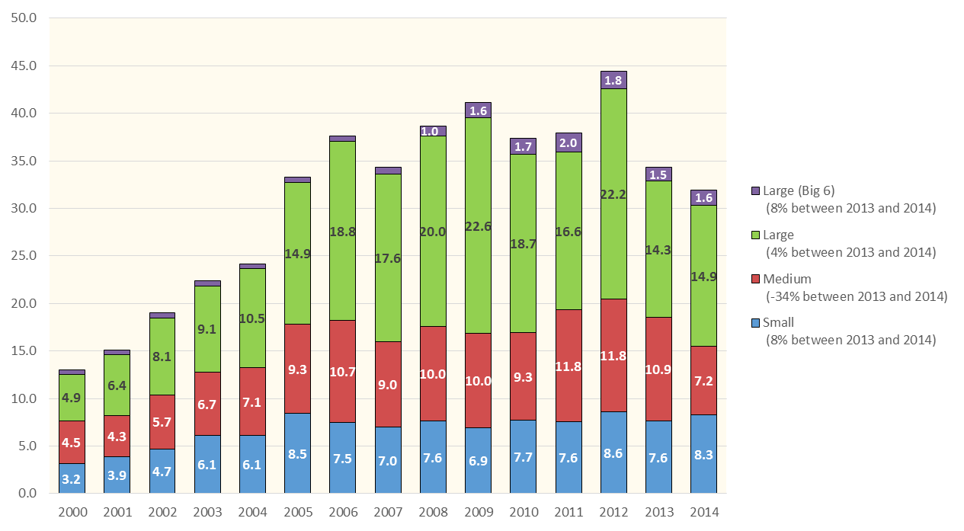
DLA Contract Obligations by Vendor Size, 2000-2014
Vendor Size
(% Change between
2013 and 2014)
(Overall DLA: -7% between
2013 and 2014)
Notes:
This slide shows DLA Contract Obligations by Vendor Size, 2000-2013
Large contractors (those with more than $3 billion in total corporate annual revenue), which rose as a share from 44 percent in 2011 to 49 percent in 2012, fell to 41 percent in 2013.
The share of DLA contract obligations awarded to small contractors (using federal small-business definitions) fell from around 25 percent from 2000-2005 to around 20 percent in most years since, with the share rising under sequestration from 20 percent in 2012 to 22 percent in 2013.
Medium contractors (defined as larger than small but less than $3 billion in annual corporate revenue), which had been growing at a 6.3 percent CAGR from 2009-2012, declined more slowly than overall DLA (-10 percent) under sequestration, rising as a share from 28 percent to 33 percent.

Slide 20
DLA Contract Obligations by Contract Size, 2000-2014
Notes:
This slide shows DLA Contract Obligations by Vendor Size, 2000-2013
Large contractors (those with more than $3 billion in total corporate annual revenue), which rose as a share from 44 percent in 2011 to 49 percent in 2012, fell to 41 percent in 2013.
The share of DLA contract obligations awarded to small contractors (using federal small-business definitions) fell from around 25 percent from 2000-2005 to around 20 percent in most years since, with the share rising under sequestration from 20 percent in 2012 to 22 percent in 2013.
Medium contractors (defined as larger than small but less than $3 billion in annual corporate revenue), which had been growing at a 6.3 percent CAGR from 2009-2012, declined more slowly than overall DLA (-10 percent) under sequestration, rising as a share from 28 percent to 33 percent.

Slide 21
Top 20 DLA Vendors, 2004 & 2014 (FPDS Prime Contract Obligations)
Notes:
This slide shows the Top 20 DLA Vendors, 2003 & 2013 (FPDS Prime Contract Obligations), with their prior-year rank
There has been a notable concentration of DLA contract obligations since 2003 – the top 20 DLA vendors accounted for nearly 50 percent in 2013, compared to 33 percent of DLA contract obligations in 2003,.
There was significant turnover in the top 5 between 2012 and 2013, with three vendors moving into the top 5 (Refinery Associates of Texas, World Fuel Services, and Cardinal Health), and the #1 vendor in 2012, Royal Dutch Shell, falling to 20th.
In the rest of the top 20, six vendors moved into the top 20 in 2013 from outside the top 20 in 2012: National Fuel, Total SA, McKesson, International Petroleum Investment Co., Motor Oil Hellas, and Bahrain Petroleum Company.

Slide 22
Methodology
The Federal Procurement Data System (FPDS) was the primary source for this report.
Federal regulations only require that all unclassified prime contracts worth $2,500 and above be reported to FPDS.
FPDS data are constantly being updated, including those for back years. As a consequence, the dollar totals for a given year can vary between reports.
Contract classifications sometimes differ between FPDS and individual companies, resulting in some contracts that a company considers as services being labeled as products by FPDS and vice versa.
OCO and supplementals are not separately classified in FPDS.
All dollar figures are in constant 2013 dollars
Additional charts (with breakdowns by DoD component and by Products/Services/R&D), along with full data tables, are available online at http://www.csis.org/NSPIR/DoD

Slide 23
Guidance Review and Possible Measures of Success
PBL Definitions
Measures of Success
Proof Point Study
Product Support Strategy Process Model

Slide 24
DLA Field Office PBL Definitions
How CSIS defined PBL based on responses from DLA field offices in this phase of the study:
DLA Troop Support does not appear to have any contracts past or present that in their opinion meets the “aviation-style” definition of PBLs.
DLA Aviation includes PBL-like current and past contracts that moved from DLA stocking to contractor stocking, but those contracts did not include specific requirements to improve reliability and maintainability, and therefore do not appear to meet PBL standards.
DLA Land & Maritime contracts include specific performance requirements and offer the contractor opportunities to increase profits by developing efficiencies in ordering, planning and stocking.
Notes:
This slide shows the DLA Field Office PBL Definitions that were used to identify the PBL contracts covered in slides 30-41.
How CSIS defined PBL based on responses from DLA field offices in this phase of the study:
DLA Troop Support does not appear to have any contracts past or present that in their opinion meets the “aviation-style” definition of PBLs.
DLA Aviation includes PBL-like current and past contracts that moved from DLA stocking to contractor stocking, but those contracts did not include specific requirements to improve reliability and maintainability, and therefore do not appear to meet PBL standards.
DLA Land & Maritime contracts include specific performance requirements and offer the contractor opportunities to increase profits by developing efficiencies in ordering, planning and stocking.
These definitions were used to reflect existing DLA practice and to explain the scope of the contracts included in the next section (slides 30-41).

Slide 25
Definitions of Performance Based Logistics (PBL)
Main Definition: “Performance-based logistics (synonymous with performance-based product support) achieve outcomes through performance-based arrangements that deliver Warfighter requirements and incentivize product support providers to reduce costs through innovation.” (PBL Guidebook, “FAQ”, pg. 92)
Additional Phrasings:
“…A sustainment strategy that delivers affordable readiness…”
“…integrate the various product support activities of the supply chain with incentives and metrics.”
“…compress the supply chain and improve readiness…” (2001 QDR)
“…to deliver needed reliability and availability, reduce total cost, and encourage and reward innovative cost reduction initiatives.”
“…affordably and effectively satisfy Warfighter requirements (e.g., reliability, availability) and reduce Operating and Support (O&S) cost.”
Notes:
Source: PBL Guidebook

Slide 26
Measuring Success of PBL Arrangements
The PBL Guidebook lists the following attributes of effective PBLs:
Objective, measurable work description that acquires a product support outcome
Appropriate contract length, terms, and pricing strategies that encourage delivery of the required outcome
A manageable number of metrics linked to desired Warfighter outcomes and cost reduction goals
Incentives to align provider’s and Government's goals, achieve required outcomes and cost reduction initiatives
Risks and rewards shared between Government and commercial product support integrators and providers
Ensuring sufficient resources
Proper execution including consistent reporting, communication with key stakeholders, and routine performance assessments
The Guidebook recommends metrics be tailored to each individual PBL arrangement and should satisfy the “SMART” test:
(S) Specific; (M) Measurable; (A) Attainable; (R) Relevant; (T) Timely
“What gets measured, gets done” and “less is more”
Metrics must be manageable and suited to each individual PBL needs
A complete list of common PBL metrics can be found in Appendix F
Notes:
This slide shows Guidebook Measures for Success of PBL Arrangements
The PBL Guidebook lists the following attributes of effective PBLs, but there is no defined hierarchy of desired measures:
Objective, measurable work description that acquires a product support outcome
Appropriate contract length, terms, and pricing strategies that encourage delivery of the required outcome
A manageable number of metrics linked to desired Warfighter outcomes and cost reduction goals
Incentives to align provider’s and Government's goals, achieve required outcomes and cost reduction initiatives
Risks and rewards shared between Government and commercial product support integrators and providers
Ensuring sufficient resources
Proper execution including consistent reporting, communication with key stakeholders, and routine performance assessments
The Guidebook recommends metrics be tailored to each individual PBL arrangement and should satisfy the “SMART” test:
(S) Specific; (M) Measurable; (A) Attainable; (R) Relevant; (T) Timely
“What gets measured, gets done” and “less is more”
Metrics must be manageable and suited to each individual PBL needs
A complete list of common PBL metrics can be found in Appendix F of the Guidebook

Slide 27
2010 “Proof Point” Study
The 2010 “Proof Point” study, chartered by the Assistant Secretary of Defense for Logistics and Materiel Readiness, examined the impact of performance-based arrangements on Life Cycle Costs
Hypothesis tested by study: “Sustaining materiel via Performance Based Logistics arrangements delivers improved readiness at reduced life cycle costs.”
10 characteristics (‘Tenets’) were identified as critical to success of PBL arrangements
Positive correlation between strong adherence to PBL tenets and realized cost savings
Conclusion: PBL arrangements reduce cost per unit-of performance while improving system, subsystem, or component readiness, but in order to be successful, these arrangements require “standard repeatable processes”
Notes:
This slide describes the analytical touchstone for PBLs, the 2010 Proof Point Study
The 2010 “Proof Point” study, chartered by the Assistant Secretary of Defense for Logistics and Materiel Readiness, examined the impact of performance-based arrangements on Life Cycle Costs
Hypothesis tested by study: “Sustaining materiel via Performance Based Logistics arrangements delivers improved readiness at reduced life cycle costs.”
10 characteristics (‘Tenets’) were identified as critical to success of PBL arrangements (see next slide)
Positive correlation between strong adherence to PBL tenets and realized cost savings
Conclusion: PBL arrangements reduce cost per unit-of performance while improving system, subsystem, or component readiness, but in order to be successful, these arrangements require “standard repeatable processes”
[Source for slides 27-29 is the Proof Point study as referenced in the PBL Guidebook, May 2014]

Slide 28
Tenets of PBL | Description
Tenets Tied to Arrangement | Acquire clearly defined Warfighter-relevant outcomes Use measurable and management metrics that accurately assess the product support provider’s performance against delivery of targeted Warfighter outcomes Provide significant incentives to support provider that are tied to achievement of outcomes Firm Fixed Price (FFP) contracts are generally preferred contract type Provide sufficient contract length for product support provider to recoup investments on improved product
Tenets Tied to Organization | PBL knowledge and resources are maintained for Government team and product support providers Leadership champions effort throughout their organization(s) Involvement of everyone with vested interests in outcomes Supply chain activities aligned to desired PBL outcomes Risk management is shared between government, customer, and support provider
Notes:
This slide shows the Proof Point Study’s Tenets of PBLs
Tenets Tied to Arrangement
Acquire clearly defined Warfighter-relevant outcomes.
Use measurable and management metrics that accurately assess the product support provider’s performance against delivery of targeted Warfighter outcomes.
Provide significant incentives to support provider that are tied to achievement of outcomes.
Firm Fixed Price (FFP) contracts are generally preferred contract type.
Provide sufficient contract length for product support provider to recoup investments on improved product.
Tenets Tied to Organization
PBL knowledge and resources are maintained for Government team and product support providers.
Leadership champions effort throughout their organization(s).
Involvement of everyone with vested interests in outcomes.
Supply chain activities aligned to desired PBL outcomes.
Risk management is shared between government, customer, and support provider.

Slide 29
“Proof Point” Study Methodology
Two-tiered, fact-based method utilized to test hypothesis
First tier analyzed 21 cross-Services PBL programs (weapon systems, sub-systems, and components) to assess cost per unit of performance
Second tier constituted a “financial deep dive” and “statistical deep dive” to assess linkages between PBL strategies and changes in cost
Tier 2, Step I examined cost structures, price structures, and negotiation processes of six of the 21 selected PBL programs
Tier 2, Step II evaluated materiel demand and availability and cost prediction models of five of the 21 selected PBL programs
Selected PBL programs represented various contract structures
Sample PBL programs varied in adherence to ‘PBL Tenets’ with some demonstrating strong adherence and others displaying little to no adherence
Notes:
This slide describes the Proof Point Study Methodology
Two-tiered, fact-based method utilized to test hypothesis
First tier analyzed 21 cross-Services PBL programs (weapon systems, sub-systems, and components) to assess cost per unit of performance
Second tier constituted a “financial deep dive” and “statistical deep dive” to assess linkages between PBL strategies and changes in cost
Tier 2, Step I examined cost structures, price structures, and negotiation processes of six of the 21 selected PBL programs
Tier 2, Step II evaluated materiel demand and availability and cost prediction models of five of the 21 selected PBL programs
Selected PBL programs represented various contract structures
Sample PBL programs varied in adherence to ‘PBL Tenets’ with some demonstrating strong adherence and others displaying little to no adherence

Slide 30
DLA PBL Contracts Reported by DLA Branches Summary
Past and Present Contracts Summary
Individual Contract Snapshots and Details
Anticipated or Unidentified DLA Aviation Contracts
Anticipated DLA Land & Maritime Contracts
Notes:
This section is the heart of this initial analysis. It summarizes current and potential DLA PBL Contracts and Data. The previous sections of this briefing set the overall budget situation and the DLA contracting environment, and they connect PBLs to Better Buying Power and to the defined measures of success. The next 11 slides look at DLA’s PBL contracts.
The largest contracts that most closely align with the tenets of PBL are still in DLA’s future. However, past work provides a foundation for these future efforts.
This section includes the following:
Past and Present Contracts Summary
Individual Contract Snapshots and Details
Anticipated DLA Aviation Contracts
Anticipated DLA Land & Maritime Contracts

Slide 31
Past and Present Contracts Reported by DLA Branches Summary All are indefinite delivery supply contracts, using a form of firm fixed price
Project | Bureau | Vendor | Total Size (Then Year) | Period (Fiscal Year) | Competition
Customer Pay (CP) | DLA Ground and Maritime | AM General LLC (AMG) (SP0750-06-D-9711) | $20.7M | 2006-2008 | Sole Source
Integrated Logistics Partnership (ILP) | DLA Ground and Maritime | AM General LLC (AMG) (SPM7LX-09-D-9001) | $139.1M | 2009-2014 | Sole Source
Tire Privatization Initiative (TPI) | DLA Ground and Maritime | Michelin Aircraft Tire Corp (SPM7L1-07-D-7001) Michelin Truck Tires Corp. (SPM7L10-07-D-7002) | $129.7M+ $151.9M+ Office reports $1B total | 2007-2012 2007-2011 | Full and Open Competition
Tire Successor Initiative (TSI) | DLA Ground and Maritime | Science Applications International Corporation (SAIC) (SPE7L1-14-D-0005) | $150M per year expected |  | Full and Open Competition
Hub & Blade | Aviation PBL and PBL like Efforts | SupplyCore Inc. (SPE4AX-13-D-9425) Hamilton Sunstrand (SPE4AX-14-D-9417) | $0.21M+ N/A Ongoing |  | Sole Source & Competitive (Sole Source is PBL portion)
Notes:
This slide summarizes DLA’s Past and Present Contracts
DLA and CSIS identified seven current DLA contracts that align with PBL guidebook criteria
All are indefinite delivery supply contracts, using a form of firm fixed price
Each of these contracts is individually explored in the following slides.
Two of the seven contracts do not have contract obligation data available in the public version of FPDS as of September 23, 2014. As such data become available, they will be incorporated into the next update.
Individual Contract Snapshots and Details are provided for:
Customer Pay
Integrated Logistics Partnership
Tire Privatization Initiatives (1 and 2)
Tire Successor Initiative
Hub & Blade (2)

Slide 32
Customer Pay (CP) (SP0750-06-D-9711) DLA Land and Maritime
VENDOR: AM General, LLC (Medium Vendor) | START: 02/06/2006 | END: 12/11/2007
COMPETED: Full and Open (After exclusion of sources) | CONTRACT TYPE: Firm Fixed Price
SUPPLY/SERVICE: Supply | CONTRACT VEHICLE: Indefinite Delivery Contract (IDC)
TOTAL OBLIGATIONS: $20.7 Million | BASE AND ALL OPTIONS VALUE: N/A
DESCRIPTION: Integrator responsible for managing, storing, and delivering DLA, Army, and contractor inventory directly to multiple depot production lines performing HMMWV repair and HMMWV recapitalization (RECAP), which restores each vehicle to zero miles/zero hours "like new" condition. Predecessor of ILP.
Notes:
Notes apply to this slide (Customer Pay) and the next one (Integrated Logistics Partnership) (pt. 1 of 2)
Key traits:
Integrated purchasing for Army and USMC.
Billing at time of consumption, eliminating need for advanced procurement .
Transactional process that increased integrator control and monitoring of supply chains, allowing the contractor to follow usage patterns better.
Performance:
Virtually eliminated the problem of HMMWVs coming off the production line unfinished (missing parts), saving over $75M in overall held-vehicle inventory costs.
Over 25 million parts have been provided to rebuild over 60,000 HMMWVs, saving the Army over $86M in parts inventory costs (76% reduction in Army-owned RECAP inventory).
Material availability exceeds 99% percent at each depot work station. RECAP cost per vehicle is reduced by 7-9%, saving $3400-$4500 per HMMWV.
Two Army depots won awards for production & efficiency, enabled by strong contractor performance.

Slide 33
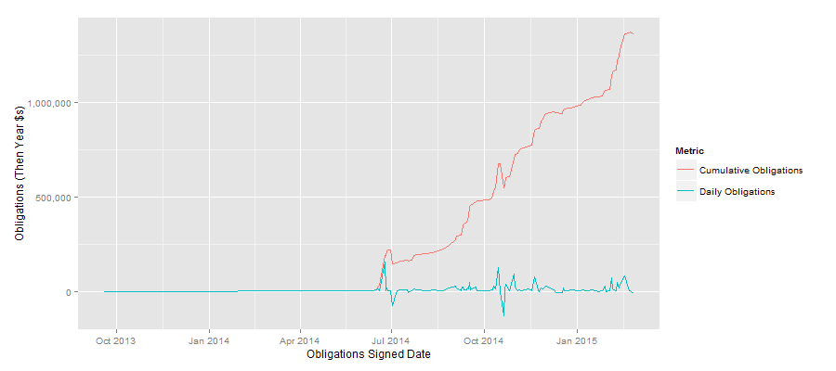
Integrated Logistics Partnership (ILP) (SPM7LX-09-D-9001) DLA Land and Maritime
VENDOR: SupplyCore Inc. (Small Business according to Gov’t) | START: 06/11/2014 | END: Ongoing (05/01/2015) Last Date to Order: 06/06/2017
COMPETED: Mixed, sole source component uses incentives. | CONTRACT TYPE: Firm Fixed Price
SUPPLY/SERVICE: Supply | CONTRACT VEHICLE: Indefinite Delivery Contract (IDC)
TOTAL OBLIGATIONS: $1,422.7 Million | BASE AND ALL OPTIONS VALUE: $1,432.7 Million
DESCRIPTION: Integrator responsible for managing, storing, and delivering DLA, Army, and contractor inventory directly to multiple depot production lines performing HMMWV repair and HMMWV recapitalization (RECAP), which restores each vehicle to zero miles/zero hours "like new" condition.
Notes:
Notes apply to this slide (Customer Pay) and the previous one (Integrated Logistics Partnership) (pt. 2 of 2)
Metrics Used: * Cost per vehicle-total cost to produce HMMWV on depot maintenance program and RECAP program.
* Program Data-total dollar value and the total materiel value for both the depot maintenance program and the HMMWV RECAP program.
* Stock out rates-# of provider parts not available at the designated delivery points when needed divided by the # of provider parts consumed.
* Quality defects-# of stock-outs on the line caused by non-conforming provider parts
Lessons Learned:
Need better inventory tracking within DLA and to ensure existing stocks get run down first.
DoD needs improved tracking of indirect cost savings to see the full benefits.
Program was a net benefit, but many of the costs ended up falling on DLA-side while the benefits were on the Army/USMC side.
PBL boundary issues (as Proof Point discusses, few contracts adhere to all tenets):
The metrics are primarily based on minimums rather than steadily escalating goals, making the contracts less conforming to all of the PBL tenets, but nonetheless with substantial performance benefits.
The performance goals are maintenance oriented rather than end-user oriented. The HMMWVs would get back in action faster and cheaper, but “better” was outside of scope.

Slide 34
Tire Privatization Initiative (TPI, 1) (SPM7L1-07-D-7001) DLA Land and Maritime
VENDOR: Michelin Aircraft Tire Corp. (Large $3B+ Vendor) | START: 1/23/2007 | END: 2/08/2012
COMPETED: Full & Open Competition | CONTRACT TYPE: Firm Fixed Price with Economic Price Adjustments
SUPPLY/SERVICE: Supply | CONTRACT VEHICLE: Indefinite Delivery Indefinite Quantity (IDIQ)
TOTAL OBLIGATIONS: $129.7 Million reported in FPDS, total value of both parts of TPI should reach $1 billion suggesting underreporting in FPDS. | BASE AND ALL OPTIONS VALUE: $139.9 Million reported in FPDS, total value of both parts of TPI should reach $1 billion suggesting underreporting in FPDS.
DESCRIPTION: Integrator to procure, store and distribute tires to the U.S. military.
Notes:
Notes apply to this slide (Tire Privatization Initiative 1) and the next one (Tire Privatization Initiative 2) (pt. 1 of 2)
Innovations:
Enterprise model: Michelin supplied tires for nearly every aircraft and ground vehicle used by the US military from 2007-2012.
Michelin received four consecutive DLA Best Value Awards from 2008-2011 for consistently meeting performance requirements.
Estimated savings, including procurement, storage and distribution of , was $173M.
Critiques (addressed in the follow-on TSI):
Under TPI, a tire manufacturer (original equipment manufacturer) served as the prime contractor and supply chain integrator and made sourcing decisions on tires when multiple manufacturers’ tires were approved for a given NSN. This gave rise to a perception of favoritism by other manufacturers.
PBL boundary issues (as Proof Point discusses, few contracts adhere to all tenets):
As with Customer Pay and the Integrated Logistics Partnership, the measures are maintenance focused. TSI goes on to split the logistics and the procurement portions of the contract, which would allow the government to make sourcing decisions aimed at improving performance for end-users.

Slide 35
Tire Privatization Initiative (TPI, 2) (SPM7L1-07-D-7002) DLA Land and Maritime
VENDOR: Michelin Truck Tires Corp. (Large $3B+ Vendor) | START: 2/14/2007 | END: 8/11/2010
COMPETED: Competitive | CONTRACT TYPE: Firm Fixed Price with Economic Price Adjustments
SUPPLY/SERVICE: Supply | CONTRACT VEHICLE: Indefinite Delivery Indefinite Quantity (IDIQ)
TOTAL OBLIGATIONS: $151.9 Million reported in FPDS, total value of both parts of TPI should reach $1 billion suggesting underreporting. | BASE AND ALL OPTIONS VALUE: $152.9 Million, total value of both parts of TPI should reach $1 billion suggesting underreporting.
DESCRIPTION: Integrator to procure, store and distribute tires to the U.S. military.
Notes:
Notes apply to this slide (Tire Privatization Initiative 1) and the previous one (Tire Privatization Initiative 2) (pt. 2 of 2)
Metrics:
Michelin consistently met or exceeded contract-mandated minimums, sustaining 98% material readiness success over the five year period while satisfying average monthly demand of around 6,360 units:
Logistics Response Times (LRT) - contract mandated minimums
Pickup Response Times (PRT) - contract mandated minimums
Expected benefits were realized.
Quarterly Performance Review Boards (PRB) were convened to track and evaluate customer satisfaction and vendor performance, but the results were not reviewed by CSIS.

Slide 36
Tire Successor Initiative (TSI) (Unknown PIID) DLA Land and Maritime
This contract has not yet been identified in FPDS
VENDOR: Science Application International (SAIC) (Large $3B+ Vendor) | START: N/A | END: N/A
COMPETED: Full & Open Competition | CONTRACT TYPE: Fixed Price with Economic Price Adjustments
SUPPLY/SERVICE: Supply | CONTRACT VEHICLE: Indefinite Quantity Contract (IQC)
TOTAL OBLIGATIONS: N/A (annual Spend $150 million) | BASE AND ALL OPTIONS VALUE: N/A
DESCRIPTION: Integrator to satisfy all DoD requirements for tires supplemented by DLA-awarded long-term contracts (LTC) and indefinite delivery purchase orders (IDPO) to tire manufacturers.
Notes:
Note: Contract obligation data for this contract are not available in the public version of FPDS as of September 23, 2014. As such data become available, they will be incorporated into the next update.
Lessons learned from Tire Privatization Initiatives that were applied to Tire Successor Initiative
Add more flexible contract support for forward stocking capability/option for combatant command (COCOM) customers that can be scaled based on global events.
Utilize DoD Transportation Systems (DTS) for OCONUS customers to provide cost saving over the commercial distribution network used under TPI.
Separating pricing of the tires and the logistics functions improves pricing transparency
Multiple long term contracts to tire suppliers, chosen by the government.
One long term contract to the logistics provider who is authorized to use the government tire contracts under FAR Part 51.
TSI structure emphasized separate areas of expertise for each of its contracts.
Estimated savings from improving on the TPI strategy exceeds $22M.

Slide 37
Hub & Blade, SupplyCore Inc. (SPE4AX-13-D-9425) DLA Aviation
VENDOR: SupplyCore Inc. (Small Business according to Gov’t) | START: 06/11/2014 | END: Ongoing (05/21/2015) Last Date to Order: 06/06/2017
COMPETED: Mixed, sole source component uses incentives. | CONTRACT TYPE: Firm Fixed Price
SUPPLY/SERVICE: Supply | CONTRACT VEHICLE: Indefinite Delivery Contract (IDC)
TOTAL OBLIGATIONS: $1.361 Million | BASE AND ALL OPTIONS VALUE: $46.1 Million
DESCRIPTION: Customer Direct/Storefront Operation for Warner Robins to correct significant support challenges as well as DLA Direct Support for Worldwide Customers
Notes:
Notes on Hub & Blade for this slide and the next one (two different contracts, two different vendors)
Key Traits:
The biggest change was a move from DLA stocking to contractor stocking.
Too soon to tell on cost-savings.
The PBL-like aspect is based on incentives in the sole-source component of the contract.
The big moves to “aviation-style” PBLs comes with the suite of future contracts (slide 40).
PBL boundary issues (as Proof Point discusses, few contracts adhere to all tenets):
As with the DLA Land & Maritime contracts, the focus is on price and ordering speed, not the performance of the parts themselves.
The biggest change was a move from DLA stocking to contractor stocking.
As with Customer Pay and the Integrated Logistics Partnership and TPI, the measures are maintenance focused.

Slide 38
Hub & Blade, Hamilton Sunstrand (SPE4AX-14-D-9417) DLA Aviation
This contract has been reported into publicly available FPDS data. However it has not yet reported any as of 5/1/2015.
VENDOR: SupplyCore Inc. (Large $3B+ Vendor) | START: 06/06/2014 | END: Ongoing (05/01/2015) Last to Order: 06/06/2017
COMPETED: Mixed, sole source component uses incentives. | CONTRACT TYPE: Firm Fixed Price
SUPPLY/SERVICE: Supply | CONTRACT VEHICLE: Indefinite Delivery Contract (IDC)
TOTAL OBLIGATIONS: $0 | BASE AND ALL OPTIONS VALUE: $90 Million
DESCRIPTION: Customer Direct/Storefront Operation for Warner Robins to correct significant support challenges as well as DLA Direct Support for Worldwide Customers
Notes:
Note: Contract obligation data for this contract are not available in the public version of FPDS as of September 23, 2014. As such data become available, they will be incorporated into the next update.
Notes on Hub & Blade for this slide are the same as for the previous one (two different contracts, two different vendors)

Slide 39
DLA Aviation Anticipated or Not Yet Identified Contracts
Project | Bureau | Description | Supply or Service | Category | Contract Timing
Boeing COI | Aviation PBL and PBL like Efforts | Strategic acquisition to reduce inventory levels, improve customer service, improve obsolescence management, and decrease transactional workload. | Supply | Sole Source | Not Reported
CFM F108 COI | Aviation PBL and PBL like Efforts | Strategic acquisition to improve performance, reduce inventor, reduce workload, and reduce material costs. | Supply | Sole Source | Not Reported
GE F Series Engines COI | Aviation PBL and PBL like Efforts | Strategic acquisition to improve performance, reduce inventor, reduce workload, and reduce direct material costs. | Supply | Sole Source | Ongoing as of November 2014
Honeywell PBL | Aviation PBL and PBL like Efforts | Prototype multi service effort from the Big Ideas Initiative. | Supply | Sole Source | Not Reported
Notes:
This slide shows Anticipated PBL Contracts from DLA Aviation
DLA Aviation is pursuing several large contracts that would dramatically reshape DLA’s profile when it comes to PBL.
DLA Aviation and DLA Land and Maritime had different data available on some contracts. These slides emphasize completeness of reporting rather than consistency of format.

Slide 40
DLA Land and Maritime Anticipated Contracts
Project | Bureau | Description | Category | Vendor | Size of Contract | Type of Contract Vehicle | Cost Basis of Contract | Contract Timing
MRAP All-Terrain Vehicle (MATV) Support Contract | DLA Land & Maritime | Integrator to provide parts to MATV Rest production line. | Sole Source | Oshkosh Defense | Projected Annual Spending $85M | Undefinitized Contract Action (UCA) | Economic Price Adjustments (EPA) | 31/10/2014
Raytheon Radar Initiative | DLA Land & Maritime | Phase 1 covers Raytheon sole source depot level reparable (DLR) assemblies and their associated consumable parts that are used to maintain multiple radar systems. | Sole Source | Raytheon | Projected Annual Spending $82M | Indefinite Delivery Indefinite Quantity (IDIQ) | Economic Price Adjustments (EPA) | 31/10/2014 for Phase 1
Notes:
This slide shows Anticipated PBL Contracts from DLA Land and Maritime
DLA Land and Maritime upcoming contracts are on a short time horizon and more closely track existing contract efforts.
As was mentioned on the prior slide, DLA Aviation and DLA Land and Maritime had different data available on some contracts. These slides emphasize completeness of reporting rather than consistency of format.

